Slide 1
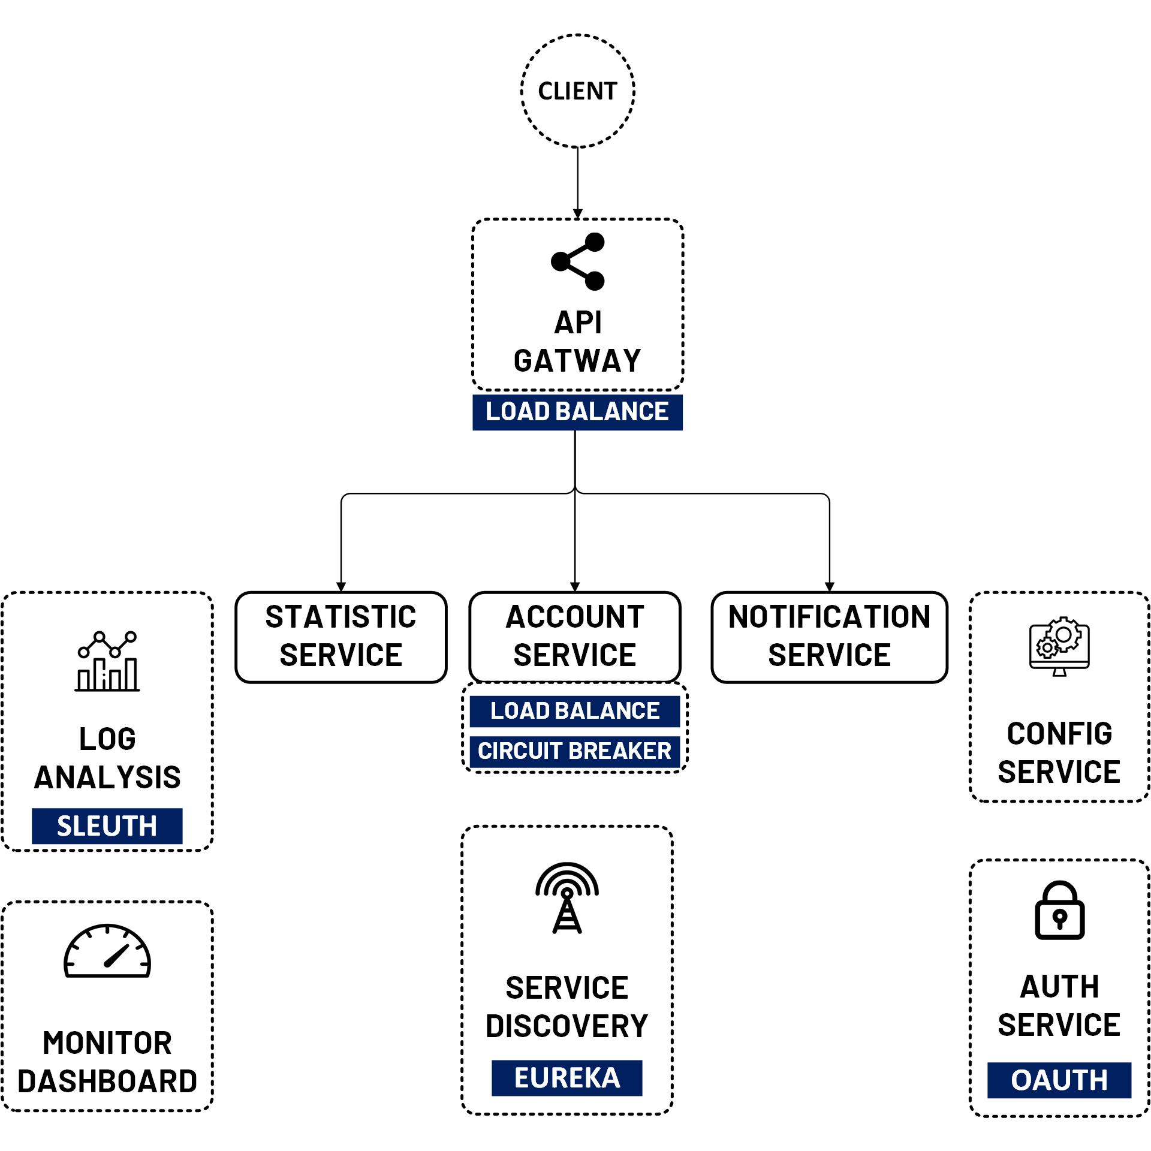

Spring Cloud Config Server
www.jmaster.io/course/microservices-with-spring-cloud

Slide 2
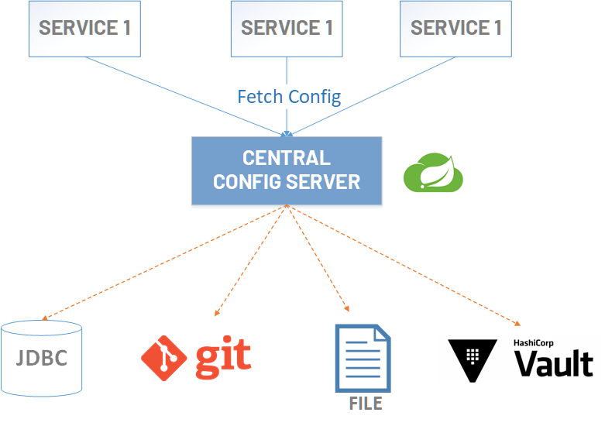
Centralized Config Server
A central place to manage external properties for applications across all environments
Server and client support for any application running in any language
Implement alternative repositories

Slide 3
